Slide 1

TensorFlow For The Masses Local Theory Data Science Meetup Zac Slade 2019-12-12

Slide 2
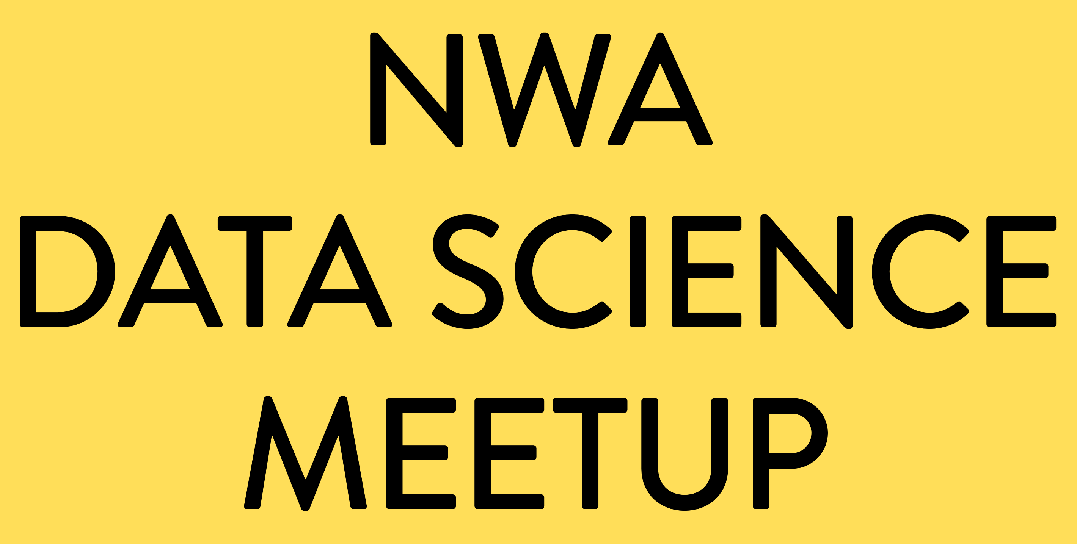
Python 3 Preliminaries
PEP 8 Style Guide
https://www.python.org/dev/peps/pep-0008/
Python Documentation
https://docs.python.org/3/

Slide 3
Python 3 Preliminaries
CODE DEMO

Slide 4
TensorFlow
Main Site
https://www.tensorflow.org/
Library Code
https://github.com/tensorflow/tensorflow
Documentation
https://www.tensorflow.org/overview/

Slide 5
TensorFlow What is a Tensor?
A tensor, is an n-dimensional array of numbers.
*Mathematicians, (please) don’t get mad.

Slide 6
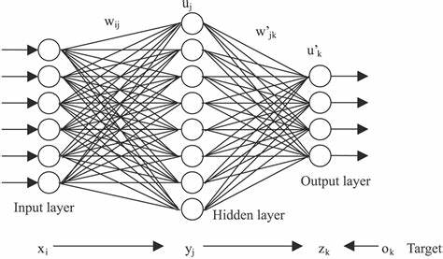
What is a Neural Network?

Slide 7
What is a Model?
A model is a mathematical object which tries to represent some process in the real world.

Slide 8
Keras Models
You can build models by hand, layer by layer, or you can use Keras to build models.
https://keras.io

Slide 9
Keras Basics
CODE DEMO

Slide 10
Off The Shelf Models
TF Hub
https://tfhub.dev
Keras Applications
https://keras.io/applications/

Slide 11
ALBERT
A State of the Art Natural Language Model:
A Lite Bidirectional Encoding of Representational Transformers

Slide 12
ALBERT
CODE DEMO

Slide 13
Thank You! Code and Slides: https://github.com/krakrjak/data-science-meetup-2019-12-12

